Slide 1
The Galileo Digital Curriculum Platform
Technology Supporting Arizona Educators in the Digital Age
Presented by
Sarah Callahan Estrada, Ph.D.
Senior Research Scientist
Assessment Technology Incorporated

Slide 2
Why Implement a Digital Curriculum Platform?
Curriculum developers desire robust technology to build standards-aligned units including quality digital content
Educators desire a digital hub to collaborate, plan, and access standards-based curriculum, instructional, and assessment content
Students desire online instructional materials and information about their progress to help them learn
Parents desire easy digital access to curriculum, resources, and information about student progress to help support student learning at home

Slide 3
Overview- The Galileo Digital Curriculum Platform
Enables rapid development and use of multi-media digital curriculums, units, lesson plans, instructional materials, and assessments
Supports Arizona standards alignment in all grades and content areas
Fully integrated and included at no additional cost with broader Galileo K-12 Online assessment and reporting system
Digital Curriculum Platform
Instruction
Assessment
Reporting
Curriculum
Built on the foundation of the ATI research and development program
Developed in collaboration with educators across Arizona

Slide 4
Innovative Builder Tools for the Digital Age
Digital Curriculum Builder
Lesson Plan Builder
Dialog Builder
Create a series of online units representing a course or pacing guide and including vetted digital instruction and assessment resources
Organize digital content to plan instruction and assessment for a topic
Create online interactive multi-media lessons and assignments integrating instruction, assessment, and teacher-student communication
Builders Support Integration Of:
Slides organizing content (text, images, videos)
Standards
Instructional materials
Assessment content

Slide 5
Valuable Digital Content at Your Fingertips
A continually growing searchable bank of vetted Arizona standards-aligned instruction and assessment materials
Dialogs and Formative Assessments
Dialogs, Videos, and Activities
Lesson Plans and Curriculum Resources
Dialogs, Videos, and Activities (Dec 2016)

Slide 6
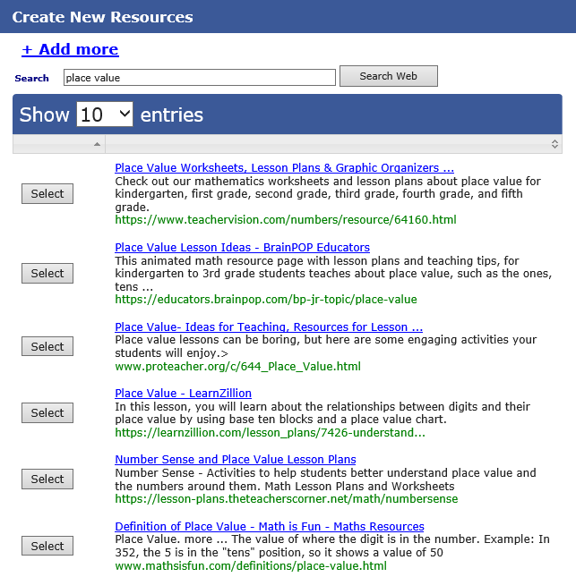
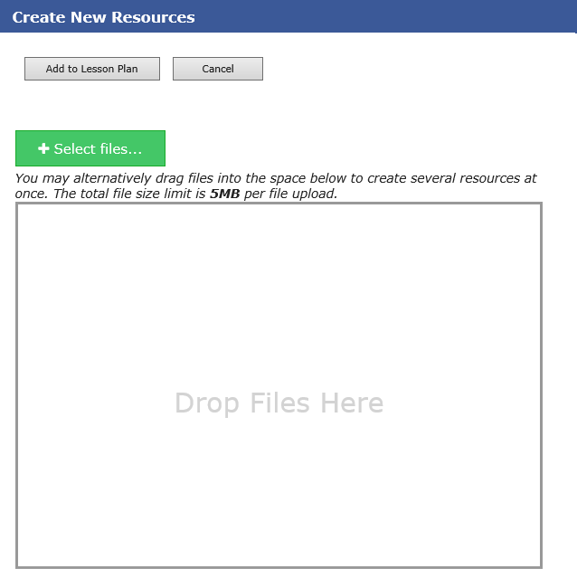
Rapid Integration of Existing and New Content
Resource Builder supports integration and sharing of weblink or file resources purchased, identified, or created by the District

Slide 7
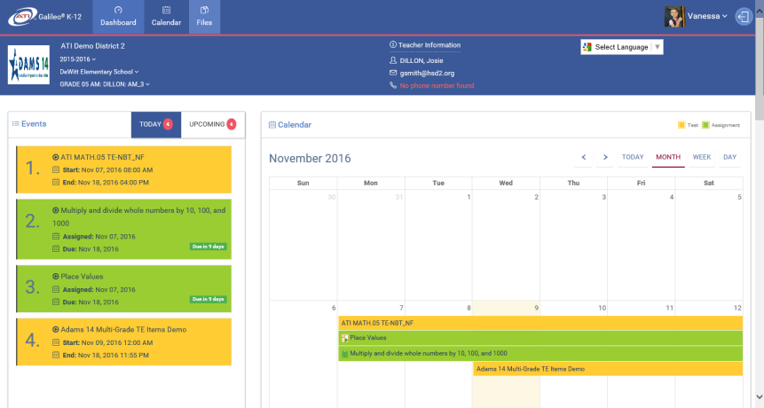
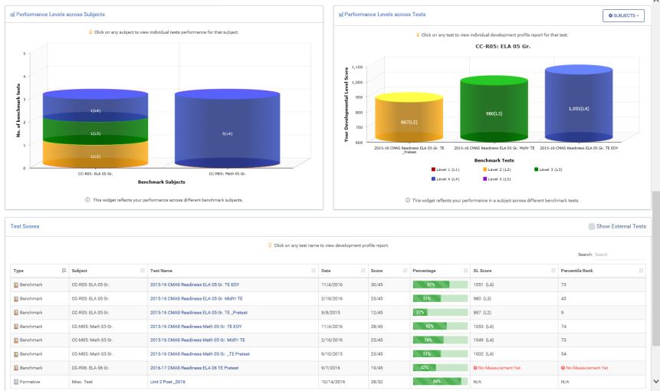
Easy Sharing of Materials with All Stakeholders
Curriculum Viewer- Disseminate curriculum units to teachers for review and use in building lesson plans
Class Calendar and Bulk Scheduler- Rapidly schedule units, lesson plans, Dialogs, and assessments in real-time
K-12 Student-Parent Center
K-12 Student-Parent Center- Provide access for students and parents to lessons, assignments, assessments, and results for all courses over multiple school years
Student Files Feature- In the Center, submit student work from Google Drive or student computer for teacher review (Dec 2016)

Slide 8
Benefits of the Galileo Digital Curriculum Platform
Integration of Instruction and Assessment Align assessment to curriculum and instruction, then use results to guide next instructional steps
Measurement of Instructional Impact Determine what works by measuring what has been taught as well as what has been learned
Flexibility and Sustainability Update and enhance curriculums in real-time to accommodate changing needs
A Single Digital Hub House all your curriculum, instruction, and assessment materials in one web-based system accessible anywhere anytime

Slide 9
Upcoming Digital Curriculum Platform Projects
Project | Target Date
Lesson Plan Viewer and Print Capability | December 2016
Learnzillion Integration | December 2016
Student Center File Submission (Google Drive) | December 2016
Dialog Builder and Dialog Viewer Redesign | January 2017
Teacher-Student Communication (Message Board) | March 2017
Dialog Monitoring Update | March 2017
SAS Curriculum Pathways Integration | May 2017

